Slide 1

Retrieval - Arrays
Complete the exam questions from last lessons worksheet.
Answer spaces are underneath the questions (S.1.a.i, S.1.a.ii, & S.1.b)

Slide 2
LO1 – Define what the “memory heap” is and how C# interacts with it
LO2 – Explain the difference between a normal & multi-dimensional array and how they can be implemented
LO3 – Utilise 2D & 3D+ arrays to solve problems

Slide 3
Concept – Memory heap
LO1 – Define what the “memory heap” is and how C# interacts with it
Memory for dynamic data structures such as lists is taken from a memory heap.
This is an amount of memory that is allocated to a program at runtime. In most high-level languages, you do not need to worry about managing the heap.
In C#, deleting a value removes it’s reference and the memory heap space is freed automatically.
In lower-level languages, such as C, you will need to manage the heap yourself.
LO2 – Explain the difference between a normal & multi-dimensional array and how they can be implemented
LO3 – Utilise 2D & 3D+ arrays to solve problems

Slide 4
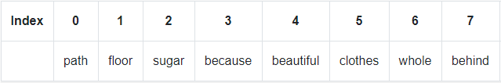

Concept – Arrays
LO1 – Define what the “memory heap” is and how C# interacts with it
LO1 - Define what a data structure is
You can think of a one dimensional array as a single row of values. Index positions begin at zero and the amount of memory taken up in the heap is static.
Individual indexes can be accessed in the following format
Identifier[index]
LO2 – Explain the difference between a normal & multi-dimensional array and how they can be implemented
LO2 - List primitive & compound data types
LO3 – Utilise 2D & 3D+ arrays to solve problems
LO3 - Explain the difference between a static and a dynamic data structure

Slide 5
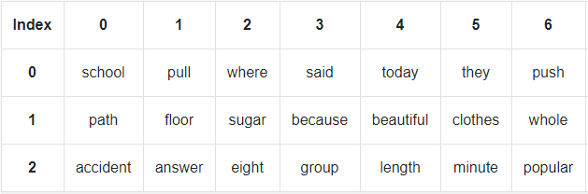

Concept – 2D Arrays
LO1 – Define what the “memory heap” is and how C# interacts with it
LO1 - Define what a data structure is
You can think of a two dimensional array as table with rows and columns.
Individual indexes can be accessed in the following format
Identifier[Index A, Index B]
LO2 – Explain the difference between a normal & multi-dimensional array and how they can be implemented
LO2 - List primitive & compound data types
LO3 – Utilise 2D & 3D+ arrays to solve problems
LO3 - Explain the difference between a static and a dynamic data structure

Slide 6
Demonstrate - Task 1
LO1 - Define what a data structure is
LO1 – Define what the “memory heap” is and how C# interacts with it
Complete task 1 on the worksheet. Add screenshots of your code once completed.
LO2 - List primitive & compound data types
LO2 – Explain the difference between a normal & multi-dimensional array and how they can be implemented
LO3 - Explain the difference between a static and a dynamic data structure
LO3 – Utilise 2D & 3D+ arrays to solve problems

Slide 7
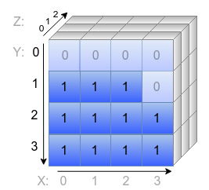

Concept – 3D+ Arrays
LO1 – Define what the “memory heap” is and how C# interacts with it
LO1 - Define what a data structure is
When you work with three or more dimensions, it is hard to visualise the data. Fortunately, in programming you do not need to do this. You just decide on the dimensions and the order in which you will index the data. Then be consistent throughout.
LO2 – Explain the difference between a normal & multi-dimensional array and how they can be implemented
LO2 - List primitive & compound data types
LO3 – Utilise 2D & 3D+ arrays to solve problems
LO3 - Explain the difference between a static and a dynamic data structure

Slide 8
Demonstrate – Task 2
LO1 – Define what the “memory heap” is and how C# interacts with it
LO1 - Define what a data structure is
Complete task 2 on today’s worksheet.
Complete the extension task if you finish before time is up.
LO2 – Explain the difference between a normal & multi-dimensional array and how they can be implemented
LO2 - List primitive & compound data types
LO3 – Utilise 2D & 3D+ arrays to solve problems
LO3 - Explain the difference between a static and a dynamic data structure

